Slide 1


Dillon Middle School
Director of Bands
mclellank@dillon.k12.sc.us
kevin.mclellan@scmea.net
(843)774-1212 ext.1107
South Carolina Music Educators Association
Kevin McLellan
Tri-M Chair SCMEA
South Carolina Music Educators Association
Kevin McLellan (SCMEA) Tri-M Chair

Slide 2
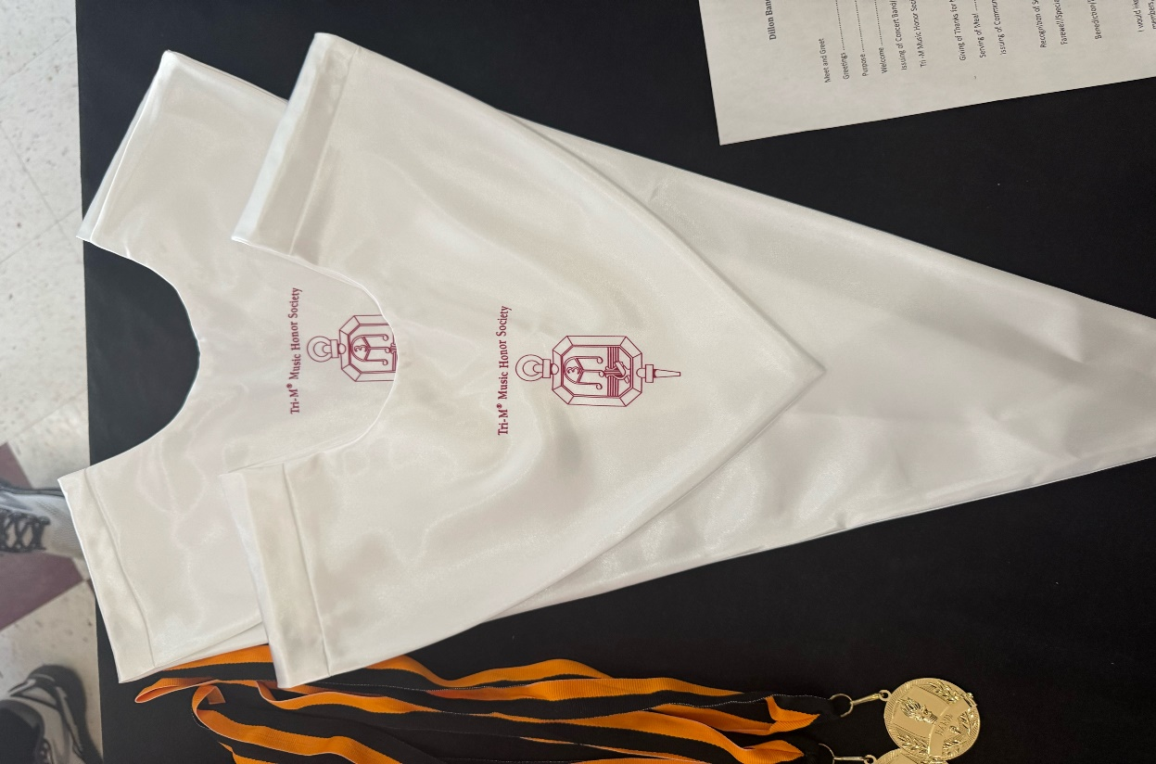
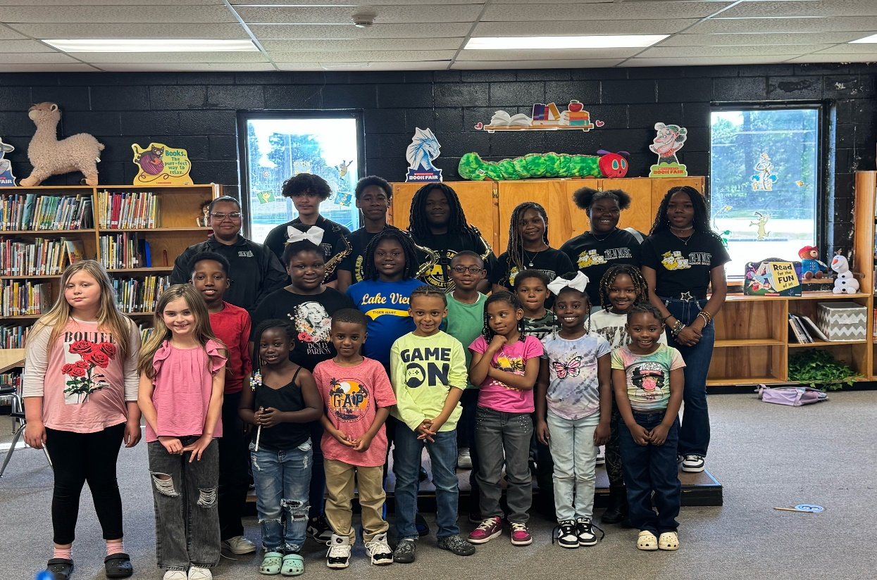
What is Tri-M?
- Tri-M is the National Music Honor Society for middle & high school students.
- Promotes unity, leadership, service, and musical excellence.
- Benefits include:
• Leadership opportunities
• Community service
• Musical recognition

Slide 3

Why Tri-M?
The only national honors society for STUDENT musicians in the country
Flexibility to mold to your program needs
Benefits outweigh the time commitment
Provides opportunities for your students to perform, lead and serve

Slide 4

Renewal Information for Tri-M Chapters
All Chapters expire on June 30th of every year
Renewal fees are currently $100 every year
Membership renewal form is online on Tri-M website.

Slide 5
Renewal Information for Tri-M Chapters
Chapter advisor may choose to collect an individual fee up to $35
Rosters of local members should be kept in a record for local chapters
Decide on local requirements for student eligibility. Tri-M student members must be enrolled in at least one music class for at least one semester, have a 2.0 GPA or C overall grade in their core classes, and a 3.0 or A, B average in their music class(es) and be of strong character

Slide 6


Decide if you would like a co-advisor
Fill out the Chapter Activation Form and send in the $100 fee
Review "Advisors Resources" tab on the National Tri-M Website
Select your candidates and appoint officers
Hold your chapter induction ceremony
Hold your first chapter meeting

Slide 7

Why Establish a Chapter?
- Empower student leaders in your music program
- Promote service and outreach through music
- Celebrate musical excellence
- Connect with other schools and state-level events

Slide 8
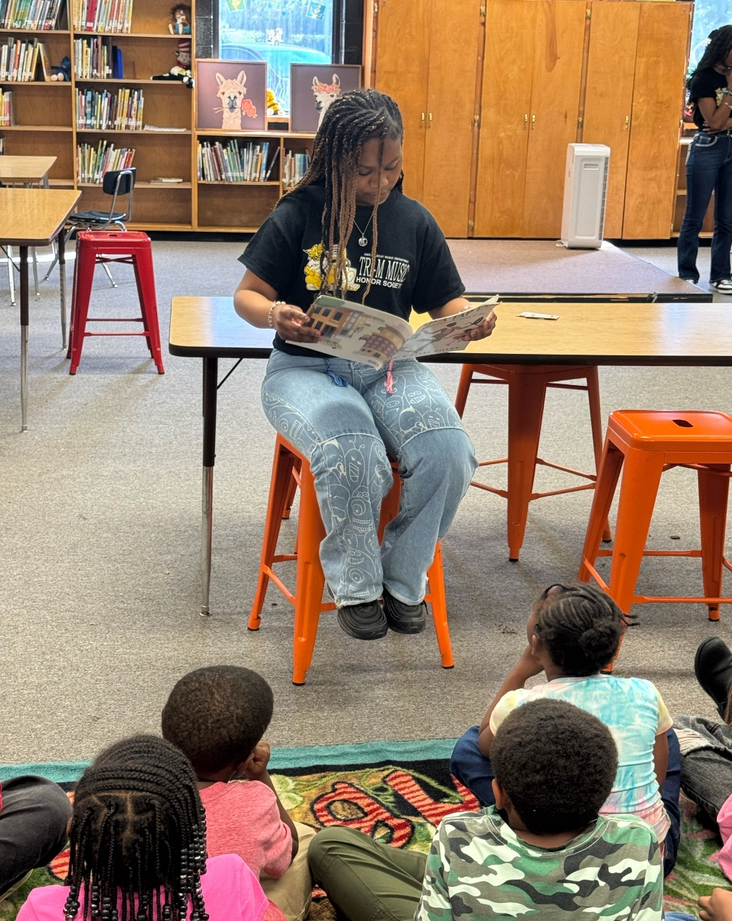
Your Voice = Our Growth
We want to hear from YOU!
- Help us understand your chapter
- Share what support you’d like at the state level
- Shape how Tri-M is involved in SCMEA events

Slide 9

SERVICE PROJECT IDEAS
TALENT SHOW
HELP MANAGE SOCIAL MEDIA PAGE
CREATE RECRUITMENT VIDEO FOR UPCOMING BEGINNERS
NOMINATE AN"ARTIST OF THE MONTH" FOR YOUR SCHOOL
HELP TUTOR
CANNED FOOD DRIVE
STAFF APPECIATION EVENTS
COMMUNITY CLEAN UP: THE SCHOOL GROUNDS/LOCATE PARK
CANDY GRAMS

Slide 10
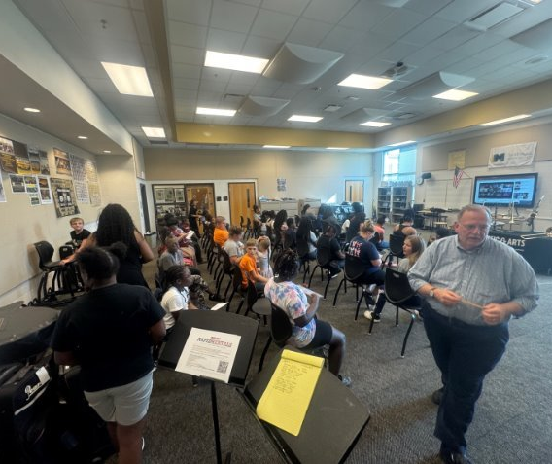
Tell Us About Your Tri-M Chapter
1. How many students are in your Tri-M chapter?
2. What would you like to see from Tri-M at the state level?
3. How could Tri-M be represented at the SCMEA Conference?
4. Which ensembles are in your chapter? (Band, Choir, Orchestra)
5. School Name & Tri-M Chapter Number
6. Do you have a chapter? If not, are you interested? Why or why not?

Slide 11
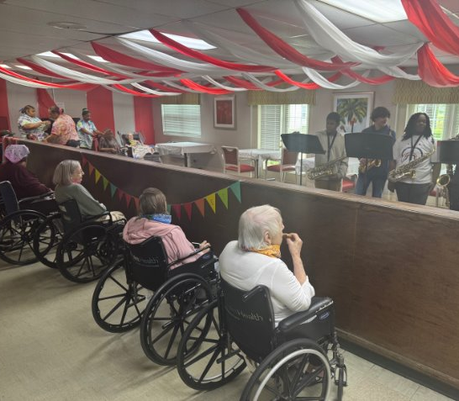
What Happens After You Respond?
- We’ll compile results and highlight active chapters
- Share opportunities for SCMEA involvement
- Provide tools to support chapter growth

Slide 12
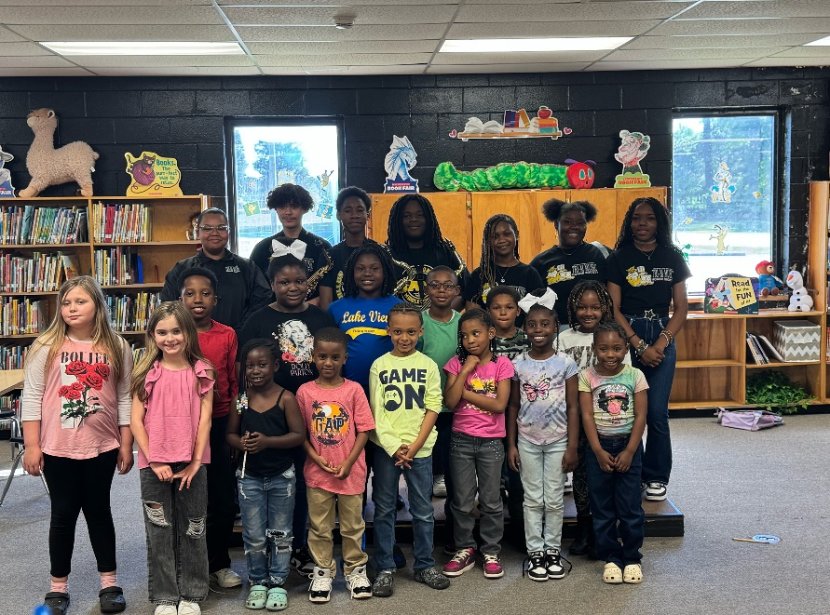
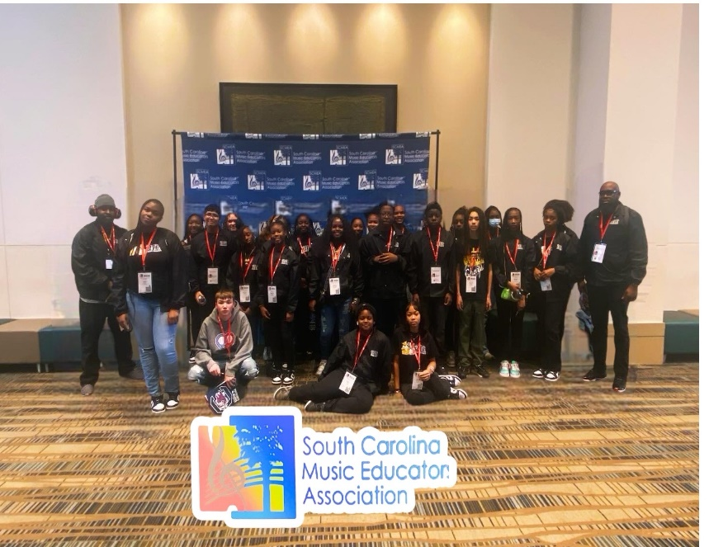
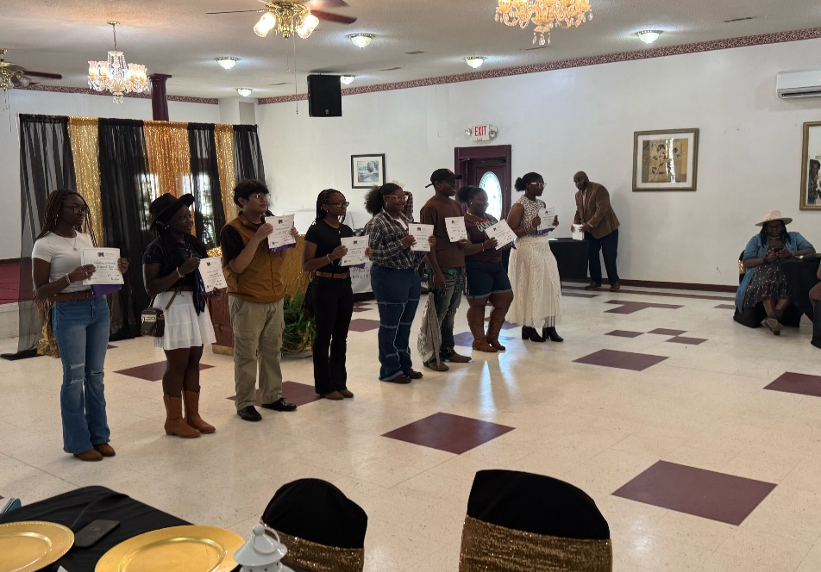
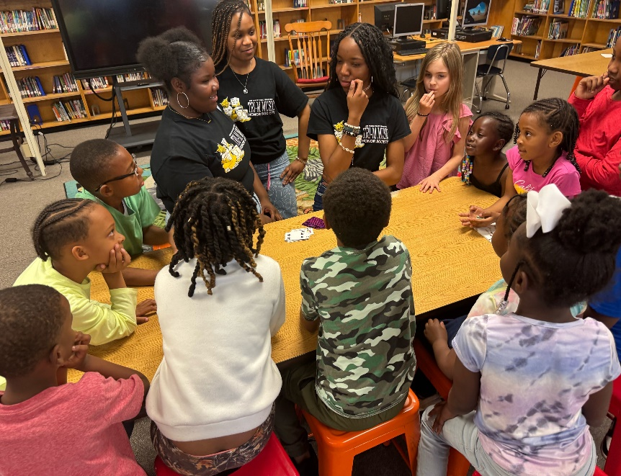
Need Help? Reach Out!
Kevin McLellan
Director of Bands
Dillon Middle School
📧 Kevin.mclellan@scmea.net

Slide 13


Help Us Grow Tri-M Across the State!
Calling All Middle & High School Music Programs

